Slide 1
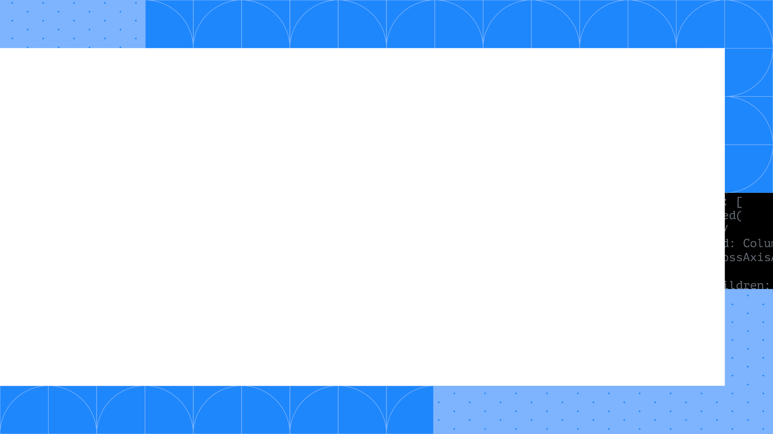
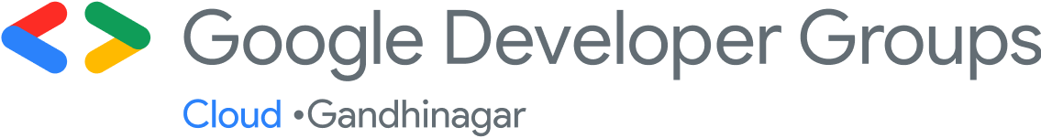

Dr. Rinkesh Bansal, Ph.D. Master Inventor & Program Director,
IBM

Slide 2
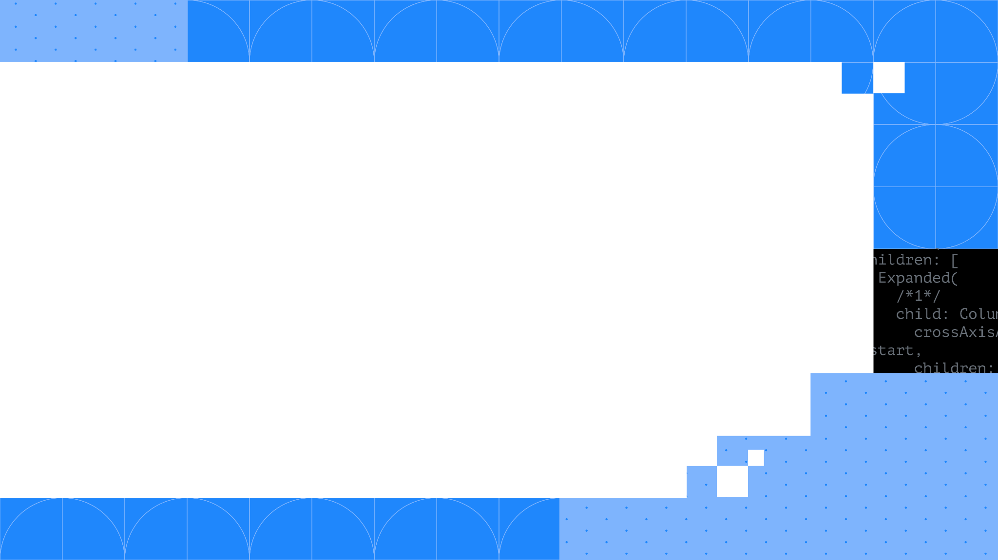
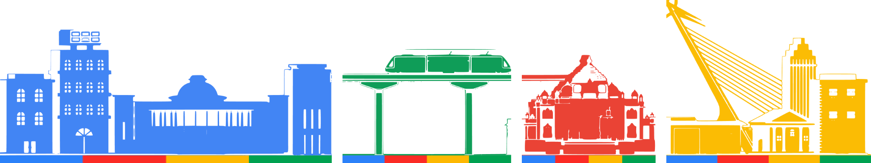
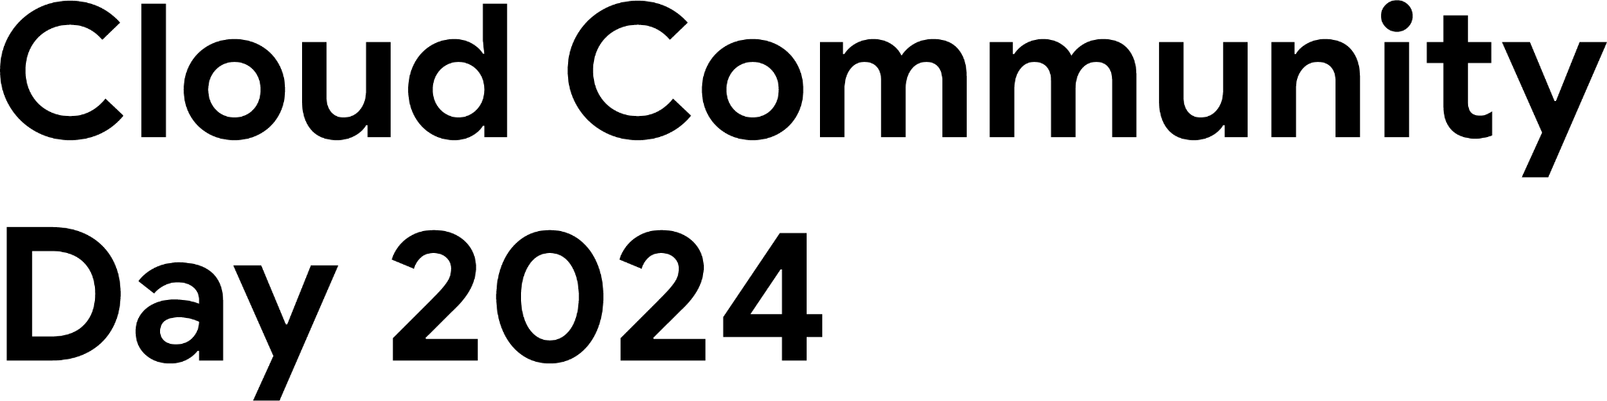
Security In Cloud
Overview

Slide 3
Basics of Security – CIA Triad
Confidentiality
Keeping data private
protecting information from unauthorized access
Integrity
Information is trustworthy and untampered
data are trustworthy, complete, and have not been accidentally altered or modified by an unauthorized user
Availability
Systems, networks, and applications must be functioning as they should and when they should
data are accessible when you need them

Slide 4
Important terms to know
Vulnerabilities
A vulnerability is a weakness, flaw, or other shortcoming in a system.
System can be infrastructure, software, process or people.
Examples are software bugs, misconfigured infrastructure, etc.
Threats
Any entity or event that could exploit a vulnerability, which could affect the confidentiality, integrity or availability of your systems, data, people, etc.
Entity could be human and/or software.
Examples: Malwares, ransomwares, phishing attacks, attackers (also called crackers & hackers)
Risks
Risk is the probability of a negative (harmful) event occurring exploiting vulnerabilities which leads to a potential loss
Risks = Threats x Vulnerabilities
Challenges
Challenges are hurdles in implementing appropriate measures to mitigate risks.

Slide 5
Risks & mitigations
Top Cloud Security Risks
Attack Surface
Cloud environment’s total exposure
Human Error
According to Gartner, 99% of all cloud security failures are due to some level of human error.
Misconfiguration
Large number of settings given by the CSPs
Most customers uses multiple CSPs making it even more confusing
Data Breach
Sensitive information is accessed by unauthorized person without your knowledge or permission
Mitigations
Regular risk assessments and hunting
Proper Risk management: Mitigate, transfer, accept, avoid
Apply security controls to mitigate the top identified risks
Notes:
https://www.crowdstrike.com/cybersecurity-101/cloud-security/cloud-security-risks-threats-challenges/
One final rule — don’t blame people for errors. Blame the process. Build processes and guardrails to help people do the right thing. Pointing fingers doesn’t help your business become more secure.
https://www.techtarget.com/searchsecurity/tip/Top-11-cloud-security-challenges-and-how-to-combat-them

Slide 6
Threats and mitigations
Top Cloud Security Threats
Zero-day vulnerabilities
Vulnerabilities in deployed software and infrastructure (operating systems, network, etc) that the vendor hasn’t patched
Advanced Persistent Threats (APTs)
Undetected, sustained and sophisticated cyberattacks for prolonged time by an intruder
Insider Threats
Threats which comes from within the organizations
Cyberattacks
Crackers, Attackers, hackers attempts to access a cloud network for the purpose of stealing, altering, exposing or destroying the sensitive information
Malwares, DDOS attacks, etc
Mitigations
Defense in Depth, multiple checking for the cloud configuration, threat hunting
Regular patching
Secure coding and standards for microservices building and deployments
Notes:
https://www.crowdstrike.com/cybersecurity-101/cloud-security/cloud-security-risks-threats-challenges/
One final rule — don’t blame people for errors. Blame the process. Build processes and guardrails to help people do the right thing. Pointing fingers doesn’t help your business become more secure.
https://www.techtarget.com/searchsecurity/tip/Top-11-cloud-security-challenges-and-how-to-combat-them

Slide 7
Challenges and mitigations
Top Cloud Security Challenges
Skills shortage and improper of cloud security strategy
Vulnerabilities in deployed software and infrastructure (operating systems, network, etc) that the vendor hasn’t patched
Improper IAM policies
Privilege creeping, roles & permissions for large number of employees and users.
Shadow IT
Hardware or software used by employees that isn't allowed or supported by their organization's IT team
Cloud Compliance
Several internal, government and industry compliance to meet which includes cross-border compliances
Mitigations
Principles of least privileges
MFAs
Upskilling, awareness programs, regular trainings, and certifications for the employees
Strong IT policy for compliance and Shadow IT
Usage of tools to tackle Shadow IT
Notes:
https://www.crowdstrike.com/cybersecurity-101/cloud-security/cloud-security-risks-threats-challenges/
One final rule — don’t blame people for errors. Blame the process. Build processes and guardrails to help people do the right thing. Pointing fingers doesn’t help your business become more secure.
https://www.techtarget.com/searchsecurity/tip/Top-11-cloud-security-challenges-and-how-to-combat-them

Slide 8
Cloud Community
Day 2024
Thank you !!!

Slide 9

Security in Cloud
Dr. Rinkesh Bansal, Ph.D.
Master Inventor & Program Director,
IBM

Slide 10
Backup

Slide 11
Top Challenges of Cloud Security
Data Breaches
Cloud Misconfigurations
Insecure APIs
Limited Visibility
Identity, credential, access and key management
Account Hijacking attacks
Cyberattacks
Insider Threats
Shadow IT
Skill shortages and staffing issues
Compliance
Notes:
https://www.techtarget.com/searchsecurity/tip/Top-11-cloud-security-challenges-and-how-to-combat-them

Slide 12
Top Challenges of Cloud Security
Complex Environment
Large Attack Surface
Loosely configured Data Security
Lack of visibility & Tracking
Ever-changing workloads
Cloud compliance and governance
Too many tools, solutions and platforms
Notes:
Increased Attack Surface
The public cloud environment has become a large and highly attractive attack surface for hackers who exploit poorly secured cloud ingress ports in order to access and disrupt workloads and data in the cloud. Malware, Zero-Day, Account Takeover and many other malicious threats have become a day-to-day reality.
Lack of Visibility and Tracking
In the IaaS model, the cloud providers have full control over the infrastructure layer and do not expose it to their customers. The lack of visibility and control is further extended in the PaaS and SaaS cloud models. Cloud customers often cannot effectively identify and quantify their cloud assets or visualize their cloud environmets.
Ever-Changing Workloads
Cloud assets are provisioned and decommissioned dynamically—at scale and at velocity. Traditional security tools are simply incapable of enforcing protection policies in such a flexible and dynamic environment with its ever-changing and ephemeral workloads.
DevOps, DevSecOps and Automation
Organizations that have embraced the highly automated DevOps CI/CD culture must ensure that appropriate security controls are identified and embedded in code and templates early in the development cycle. Security-related changes implemented after a workload has been deployed in production can undermine the organization’s security posture as well as lengthen time to market.
Granular Privilege and Key Management
Often cloud user roles are configured very loosely, granting extensive privileges beyond what is intended or required. One common example is giving database delete or write permissions to untrained users or users who have no business need to delete or add database assets. At the application level, improperly configured keys and privileges expose sessions to security risks.
Complex Environments
Managing security in a consistent way in the hybrid and multicloud environments favored by enterprises these days requires methods and tools that work seamlessly across public cloud providers, private cloud providers, and on-premise deployments—including branch office edge protection for geographically distributed organizations.
Cloud Compliance and Governance
All the leading cloud providers have aligned themselves with most of the well-known accreditation programs such as PCI 3.2, NIST 800-53, HIPAA and GDPR. However, customers are responsible for ensuring that their workload and data processes are compliant. Given the poor visibility as well as the dynamics of the cloud environment, the compliance audit process becomes close to mission impossible unless tools are used to achieve continuous compliance checks and issue real-time alerts about misconfigurations.

Slide 13
Pillars of Robust Security on Cloud
Granular, policy-based IAM and authentication controls across complex infrastructures
Zero-trust cloud network security controls across logically isolated networks and micro-segments
Enforcement of virtual server protection policies and processes such as change management and software updates
Safeguarding all applications (and especially cloud-native distributed apps) with a next-generation web application firewall
Enhanced data protection
Threat intelligence that detects and remediates known and unknown threats in real-time
Notes:
https://www.checkpoint.com/cyber-hub/cloud-security/what-is-cloud-security/
Granular, policy-based IAM and authentication controls across complex infrastructures
Work with groups and roles rather than at the individual IAM level to make it easier to update IAM definitions as business requirements change. Grant only the minimal access privileges to assets and APIs that are essential for a group or role to carry out its tasks. The more extensive privileges, the higher the levels of authentication. And don’t neglect good IAM hygiene, enforcing strong password policies, permission time-outs, and so on.
Zero-trust cloud network security controls across logically isolated networks and micro-segments
Deploy business-critical resources and apps in logically isolated sections of the provider’s cloud network, such as Virtual Private Clouds (AWS and Google) or vNET (Azure). Use subnets to micro-segment workloads from each other, with granular security policies at subnet gateways. Use dedicated WAN links in hybrid architectures, and use static user-defined routing configurations to customize access to virtual devices, virtual networks and their gateways, and public IP addresses.
Enforcement of virtual server protection policies and processes such as change management and software updates:
Cloud security vendors provide robust Cloud Security Posture Management, consistently applying governance and compliance rules and templates when provisioning virtual servers, auditing for configuration deviations, and remediating automatically where possible.
Safeguarding all applications (and especially cloud-native distributed apps) with a next-generation web application firewall
This will granularly inspect and control traffic to and from web application servers, automatically updates WAF rules in response to traffic behavior changes, and is deployed closer to microservices that are running workloads.
Enhanced data protection
Enhanced data protection with encryption at all transport layers, secure file shares and communications, continuous compliance risk management, and maintaining good data storage resource hygiene such as detecting misconfigured buckets and terminating orphan resources.
Threat intelligence that detects and remediates known and unknown threats in real-time
Third-party cloud security vendors add context to the large and diverse streams of cloud-native logs by intelligently cross-referencing aggregated log data with internal data such as asset and configuration management systems, vulnerability scanners, etc. and external data such as public threat intelligence feeds, geolocation databases, etc. They also provide tools that help visualize and query the threat landscape and promote quicker incident response times. AI-based anomaly detection algorithms are applied to catch unknown threats, which then undergo forensics analysis to determine their risk profile. Real-time alerts on intrusions and policy violations shorten times to remediation, sometimes even triggering auto-remediation workflows.

